Slide 1

Data-Driven Behavioral Analytics:
Observations, Representations and Algorithms
for Prediction and Recommendation
Meng Jiang
University of Illinois at Urbana-Champaign
Welcome to visit my homepage www.meng-jiang.com !

Slide 2
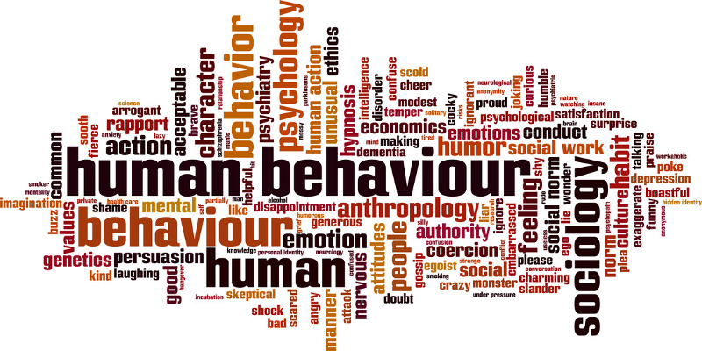
Behavior
Human behavior refers to the array of every physical action … associated with individuals, as well as the human race as a whole. (From Wikipedia)

Slide 3




Behavioral Analytics
Methodology
Understanding
Observations
Who, what, where, when, why, how… (scientific view)
Modeling
Representations
Graph, network, matrix, tensor… (mathematical view)
Intervening
Algorithms
Classification, prediction, recommendation,
anomaly detection… (application view)
#
t

Slide 4
Behavioral Analytics/Modeling

Slide 5
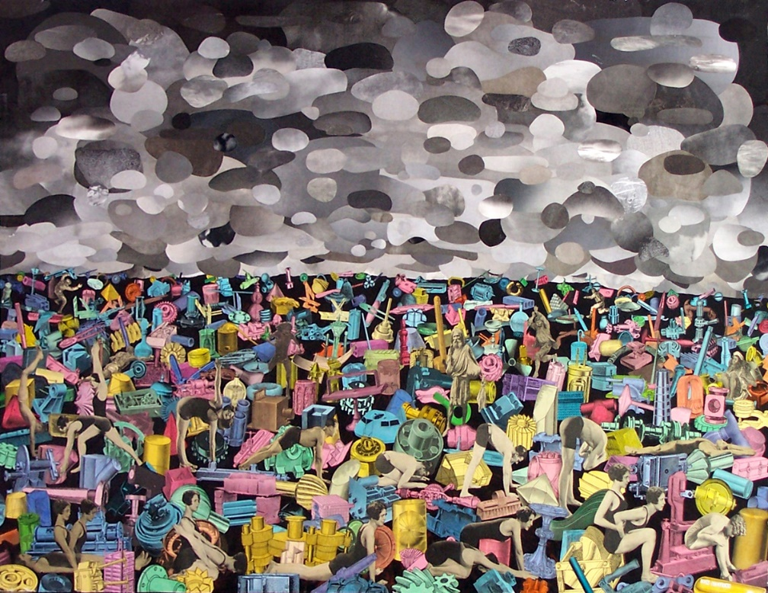
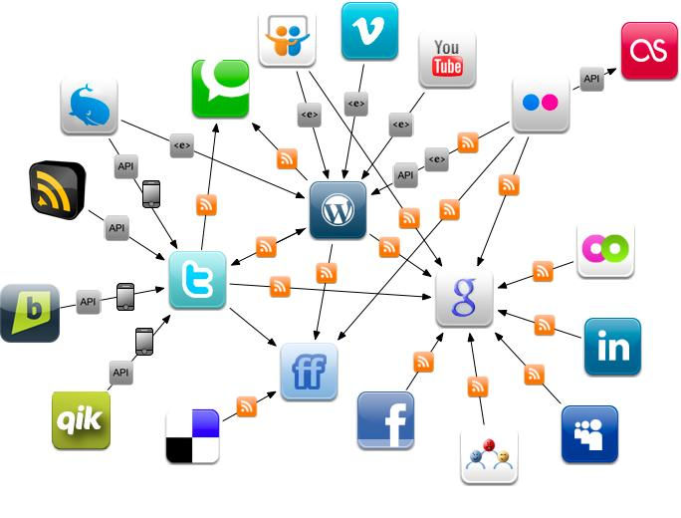
From Experience-Driven to Data-Driven
Physical World
Online Behavioral Data
The human behaviors are broadly and deeply
recorded in an unprecedented level.
This is the first time that we can get insights of human behaviors and the society from large scale real data.

Slide 6
Behaviors are Complex
Behavior
Content
Social
Context

Slide 7
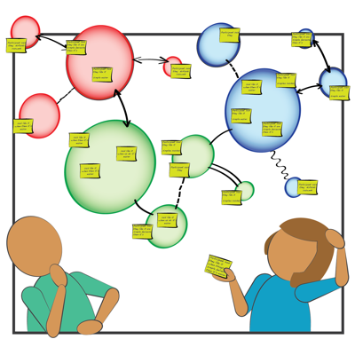
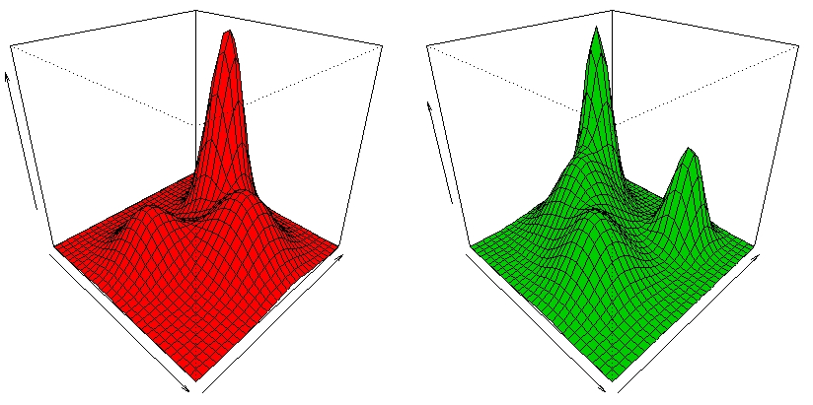
Content Related
Preference is
an important driving factor
for behavior modeling.

Slide 8
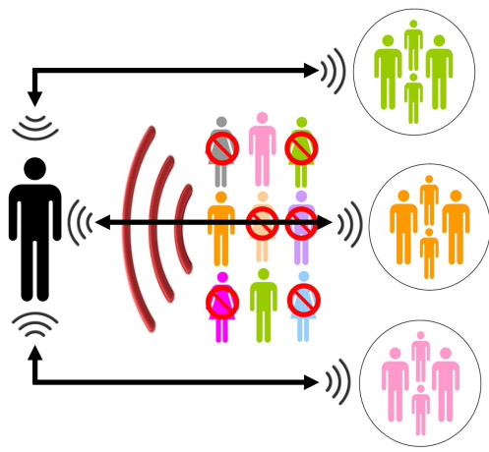
Social Related
Human behaviors
are highly dependent on
social peers.

Slide 9

Context Related
Rich contextual information:
time (when), location (where), channel (how)…

Slide 10
Modeling Complex Behavior
Behavior
Content
Social
Context
Understand single factors
Understand their couplings
Unify them for prediction and recommendation

Slide 11
Roadmap
Context
W1: Modeling social contexts (CIKM’12, TKDE’14, 129 citations) – online environment (mechanism)
W2: Modeling spatiotemporal contexts (KDD’14, 10 citations) – physical environment
Source
W3: Modeling cross-domain behaviors (CIKM’12, TKDE’15, 47 citations)
W4: Modeling cross-platform behaviors (AAAI’16)

Slide 12
Roadmap
Context
W1: Modeling social contexts (CIKM’12, TKDE’14, 129 citations) – online environment (mechanism)
W2: Modeling spatiotemporal contexts (KDD’14, 10 citations) – physical environment
Source
W3: Modeling cross-domain behaviors (CIKM’12, TKDE’15, 47 citations)
W4: Modeling cross-platform behaviors (AAAI’16)

Slide 13


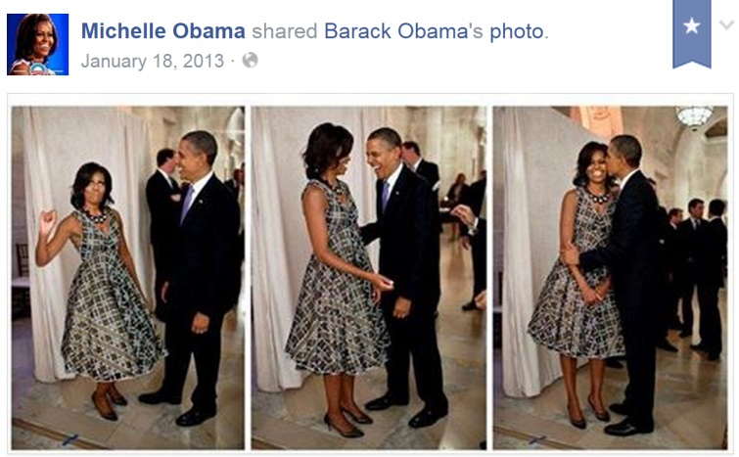
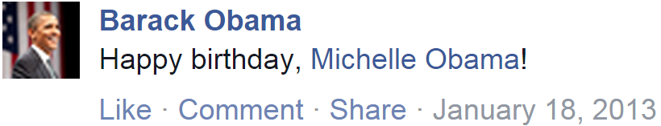
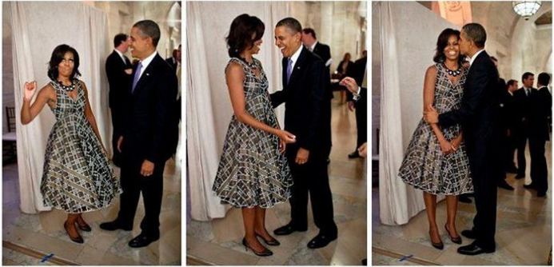
Observation: Social Network Mechanism
Birthday –
NOT politic issues
From my husband –
NOT fans/followers
(0) follow
(1) post
(2) receive & read
(3) adopt?

Slide 14
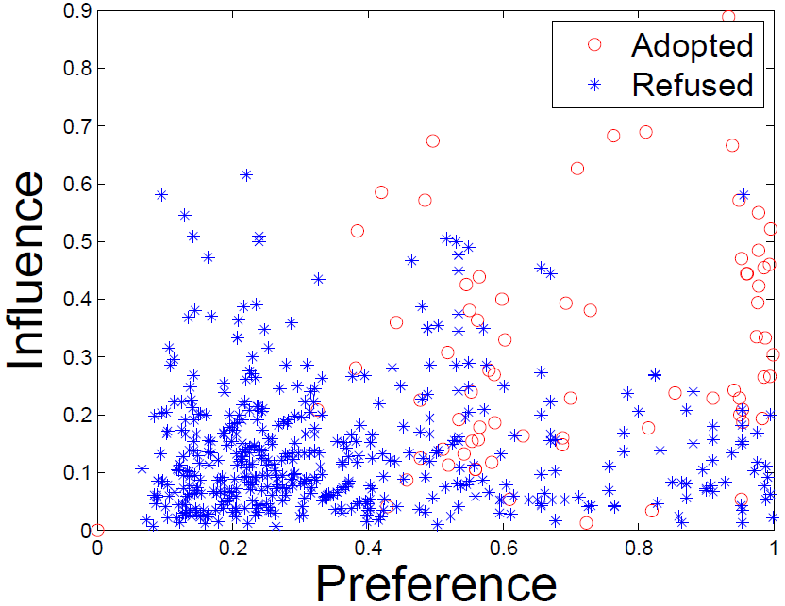
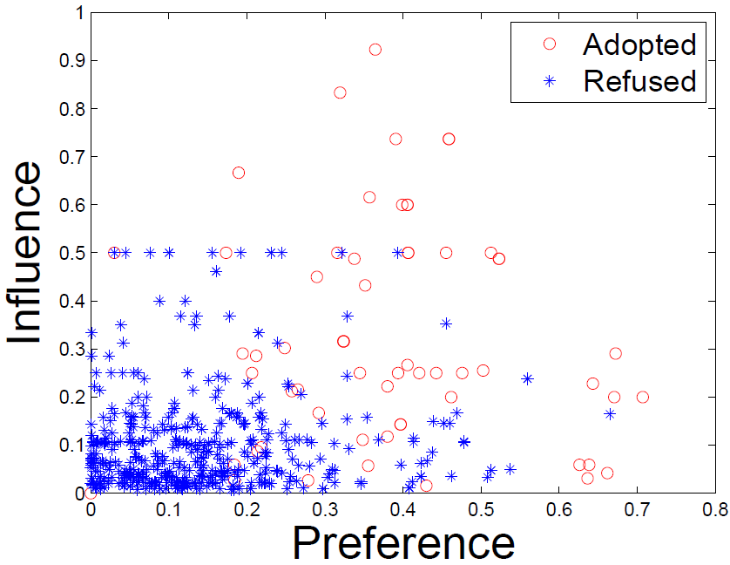
Observation: Social Contextual Factors
Individual Preference & Interpersonal Influence
China’s Facebook:
Renren
China’s Twitter:
Tencent Weibo

Slide 15
Representation: From Information to Factors
Content:
item content
Behavior:
individual preference on the given item
user-item interaction
Social:
social relation
interpersonal influence from the sender
Trust/interaction:
user-user interaction

Slide 16
Representation: From Information to Factors
Content:
item content
item latent feature V
Behavior:
individual preference on the given item
user-item interaction
user latent feature U
Social:
social relation
interpersonal influence from the sender
Trust/interaction:
user-user interaction

Slide 17
Representation: From Information to Factors
Content:
item content
item latent feature V
Behavior:
individual preference on the given item
user-item interaction
user latent feature U
Social:
social relation
item sender G
interpersonal influence from the sender
Trust/interaction:
user-user interaction
user-user influence S

Slide 18
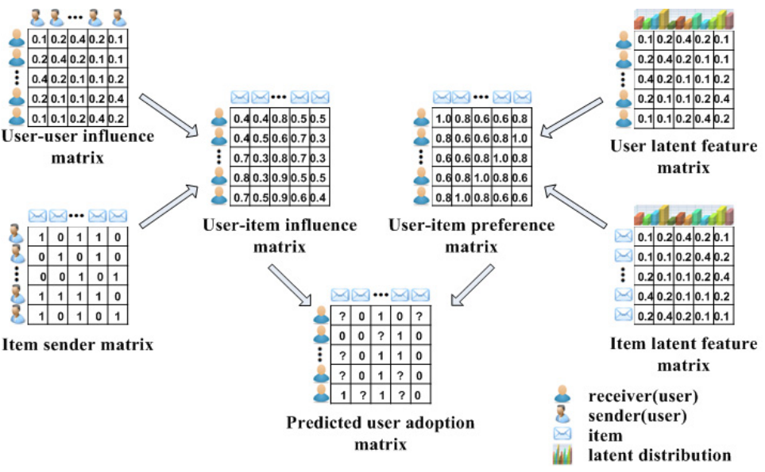
Algorithm: ContextMF Social Contextual Recommendation
S
U
G
V
R

Slide 19
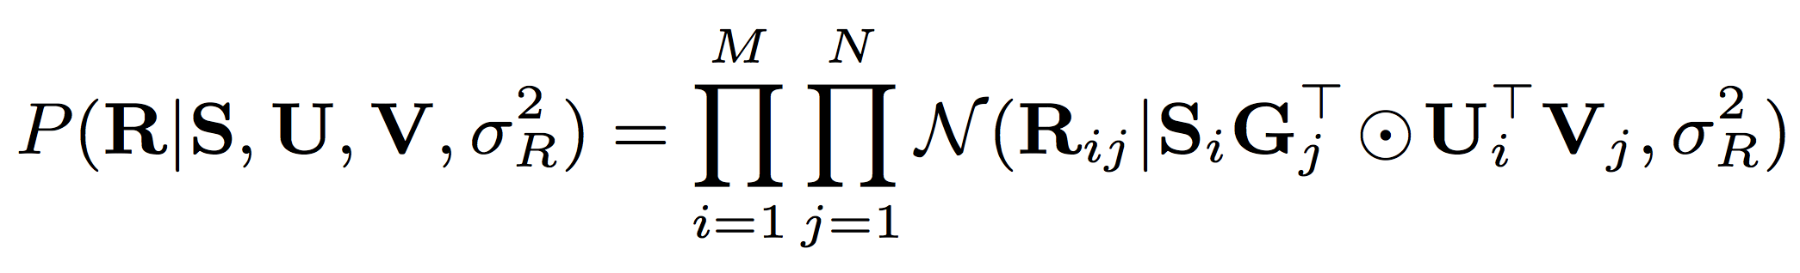
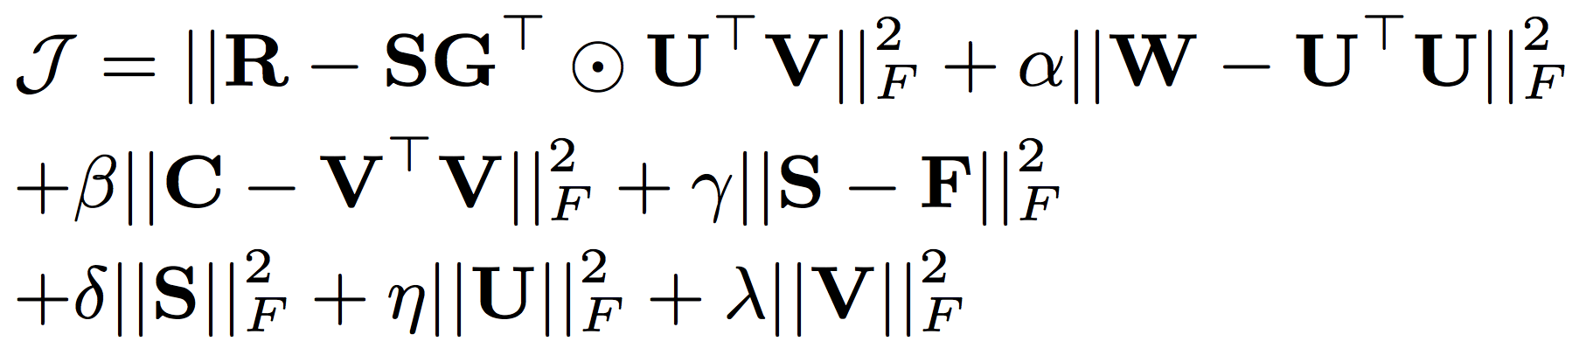
Algorithm: ContextMF Social Contextual Recommendation
behavior
influence
preference
behavior
interaction frequency/trust
item content
social relation

Slide 20
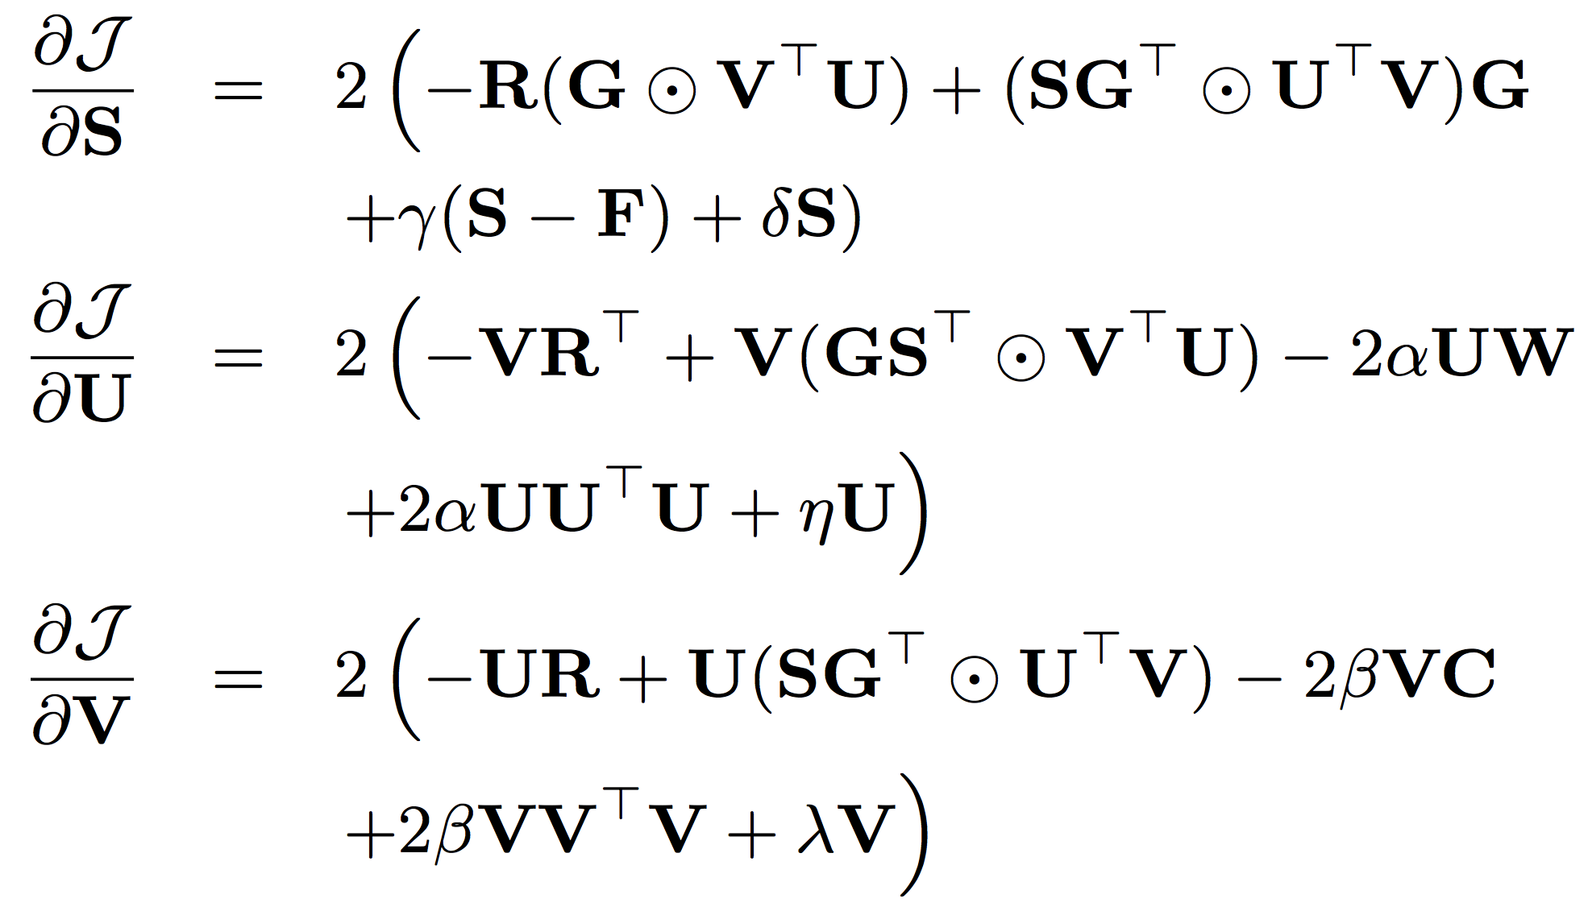
Algorithm: ContextMF Social Contextual Recommendation
Gradient
Descent
Methods

Slide 21
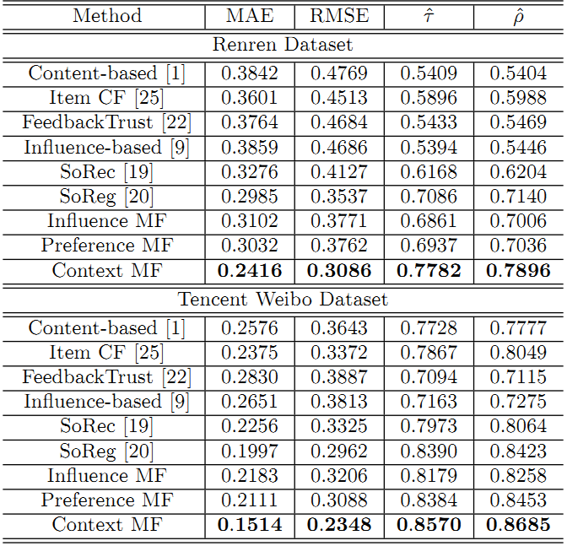
Results
 | Renren | Tencent Weibo
MAE | -19.1% | -24.2%
RMSE | -12.8% | -20.7%
Kendall’s | +9.82% | +2.1%
Spearman’s | +10.6% | +3.1%

Slide 22
Roadmap
Context
W1: Modeling social contexts (CIKM’12, TKDE’14, 129 citations) – online environment (mechanism)
W2: Modeling spatiotemporal contexts (KDD’14, 10 citations) – physical environment
Source
W3: Modeling cross-domain behaviors (CIKM’12, TKDE’15, 47 citations)
W4: Modeling cross-platform behaviors (AAAI’16)

Slide 23


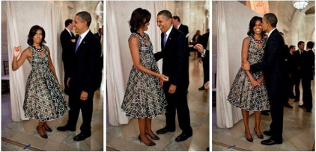

Observation: Spatial Context
Place
Device
Photo
With whom?
Who post?
Text
post
Jan. 18
Birthday party
@ White house

Slide 24
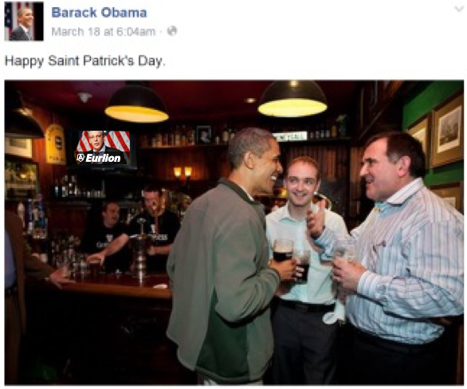
Observation: Temporal Context
Photo
Text
post
post
time
Jan. 18
Birthday party
@ White house
March 17
St. Patrick’s Day
@ Bar

Slide 25
Representation: Tensor Sequence
Tasks
time
Who post
Text
Behavior
Place
Behavior modeling
Spatial info:
Multi-faceted
Tensor sequence
Temporal info:
Dynamic
Pattern discovery
Decomposition & Completion
Behavior prediction
≈
x
x

Slide 26
Challenges: Sparsity and Complexity
Addressing sparsity: Flexible regularization with auxiliary data
Addressing high complexity: Incremental updates for projection matrix
Regularization:
Social context
user
item
…
user
item
time
t₃
t₂
time
item
item
t₁
user
user
t₁
t₂
t₃

Slide 27
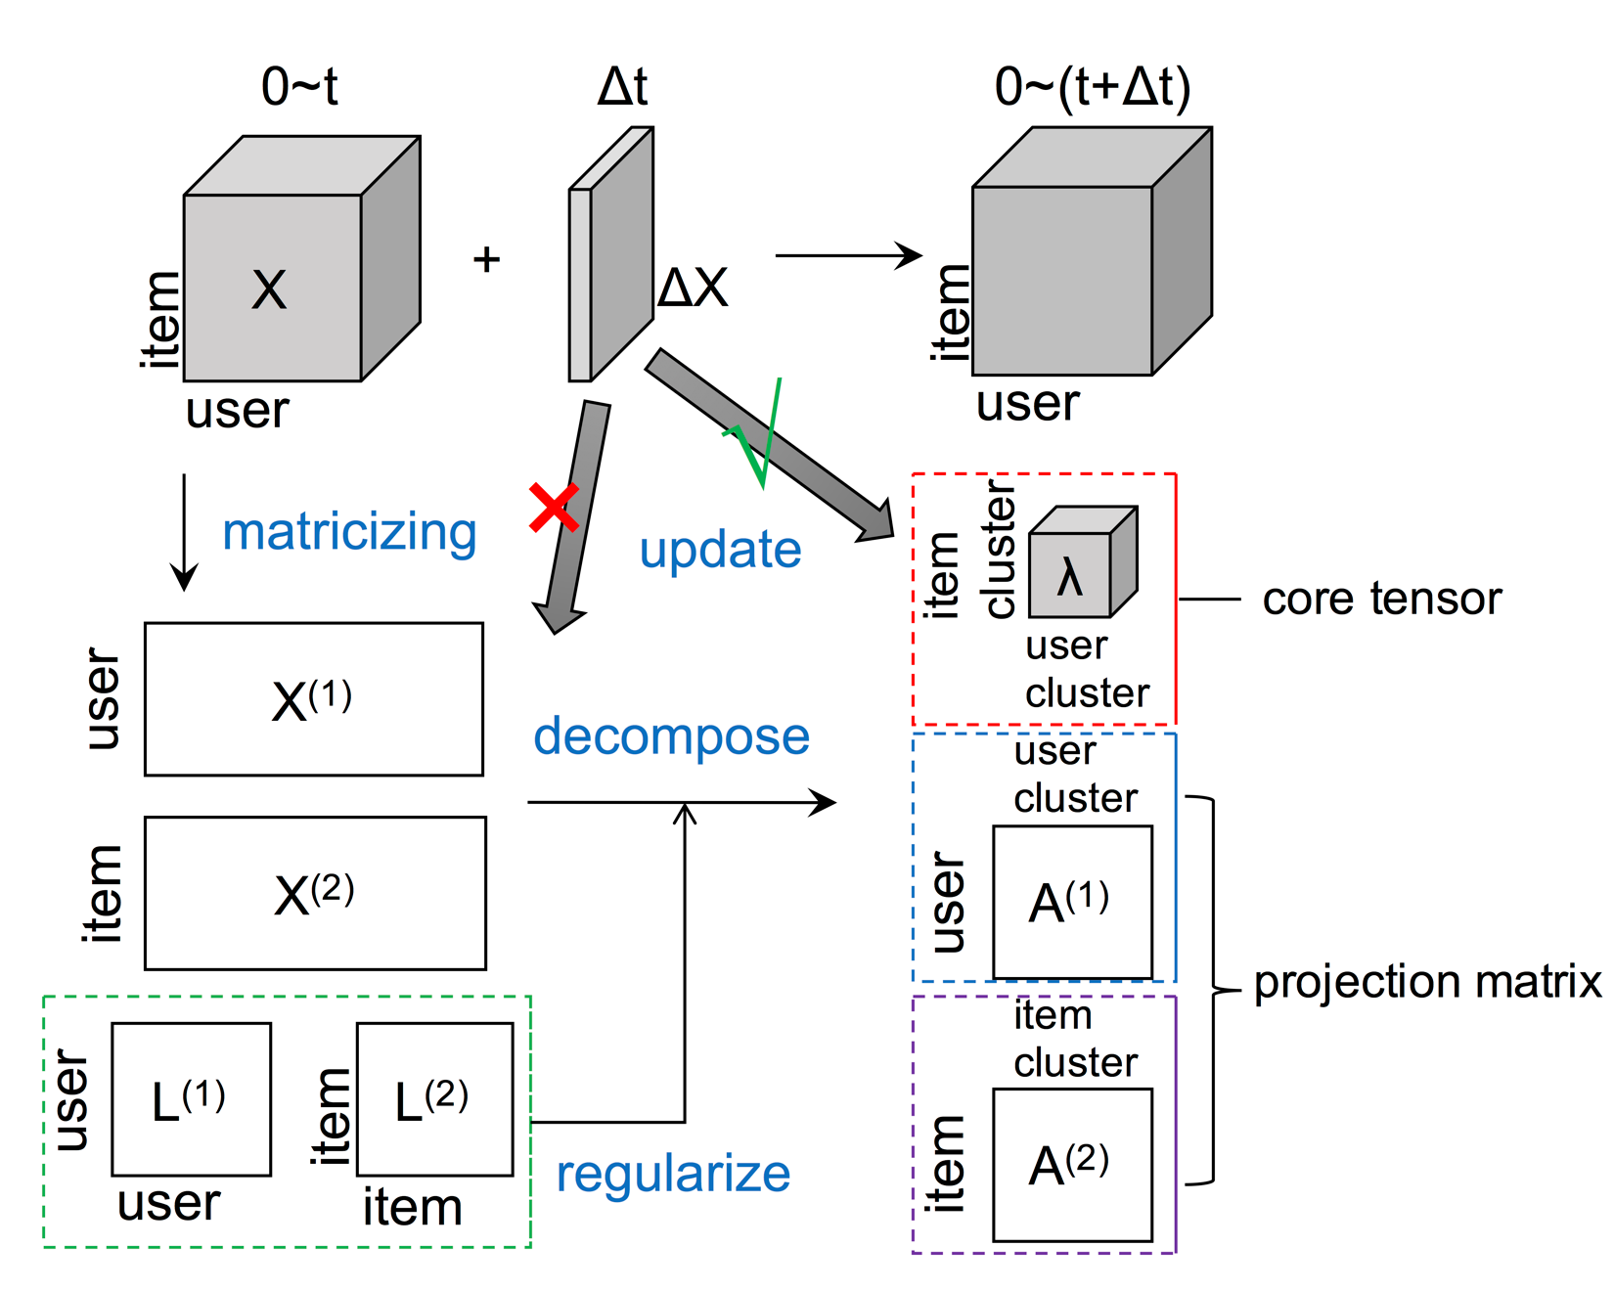
Algorithm: FEMA Flexible Evolutionary Multi-faceted Analysis

Slide 28
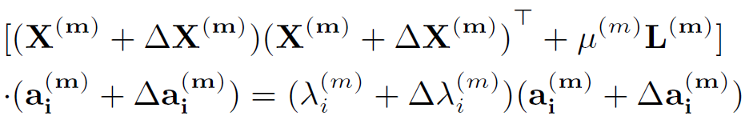
Tensor Perturbation Theory

Slide 29
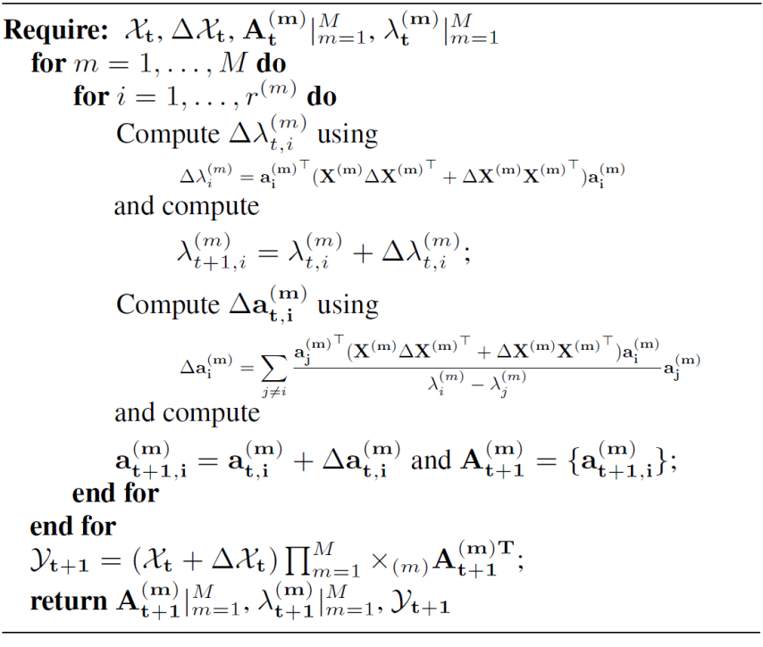
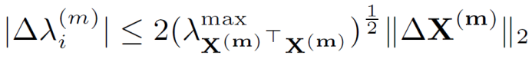
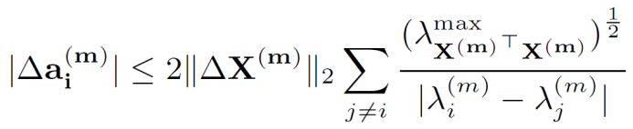
Algorithm: FEMA
Approximation
Bound Guarantee
core tensor
projection matrix

Slide 30
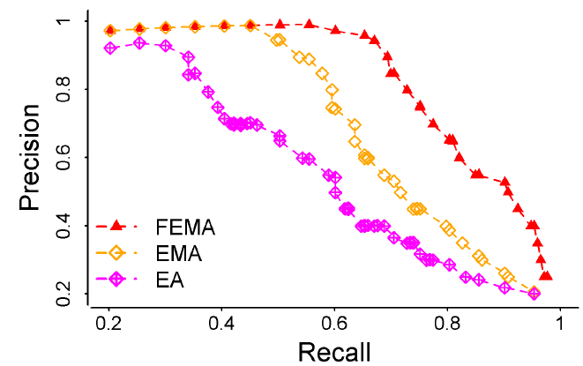
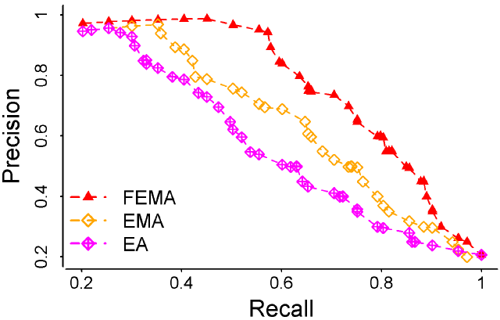
Results: FEMA > EMA > EA
 | Microsoft Academic Search |  | Tencent Weibo mentions “@”
 | MAE | RMSE | MAE | RMSE
FEMA | 0.735 | 0.944 | 0.894 | 1.312
EMA | 0.794 | 1.130 | 0.932 | 1.556
EA | 0.979 | 1.364 | 1.120 | 1.873
Precision vs Recall
X
L
X
X

Slide 31
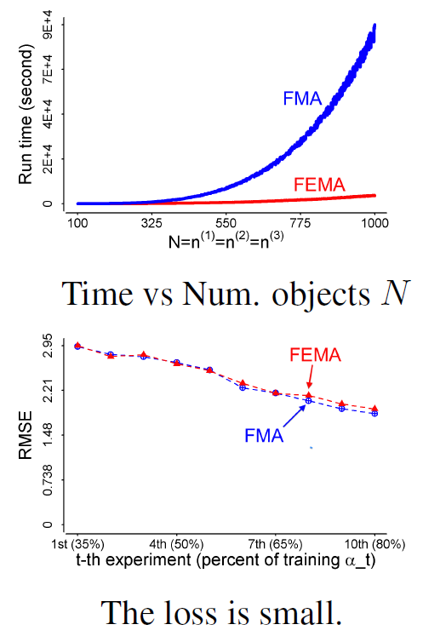
Results: Efficiency
Re-decomposition:
Re-compute projection matrices
Evolutionary analysis:
Use ΔX to update λ and a
Evolutionary analysis:
Use ΔX to update λ and a
Re-decomposition:
Re-compute projection matrices

Slide 32
Roadmap
Context
W1: Modeling social contexts (CIKM’12, TKDE’14, 129 citations) – online environment (mechanism)
W2: Modeling spatiotemporal contexts (KDD’14, 10 citations) – physical environment
Source
W3: Modeling cross-domain behaviors (CIKM’12, TKDE’15, 47 citations)
W4: Modeling cross-platform behaviors (AAAI’16)

Slide 33
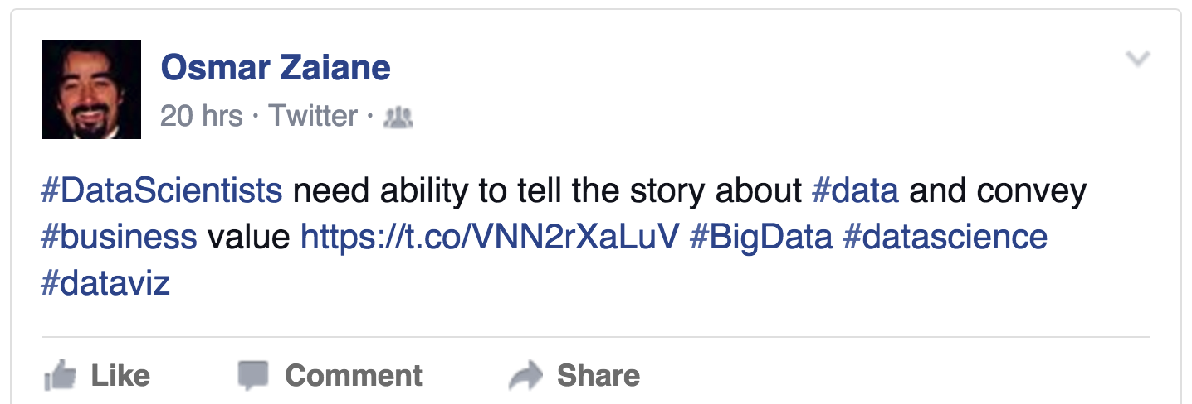
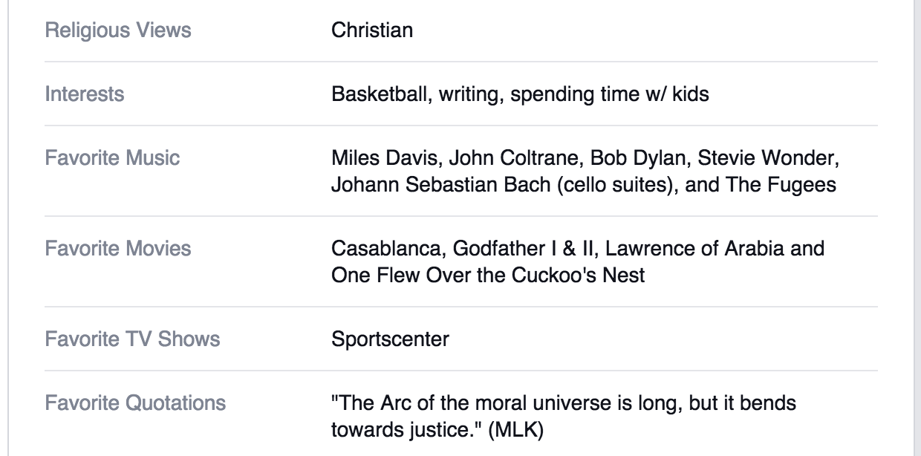
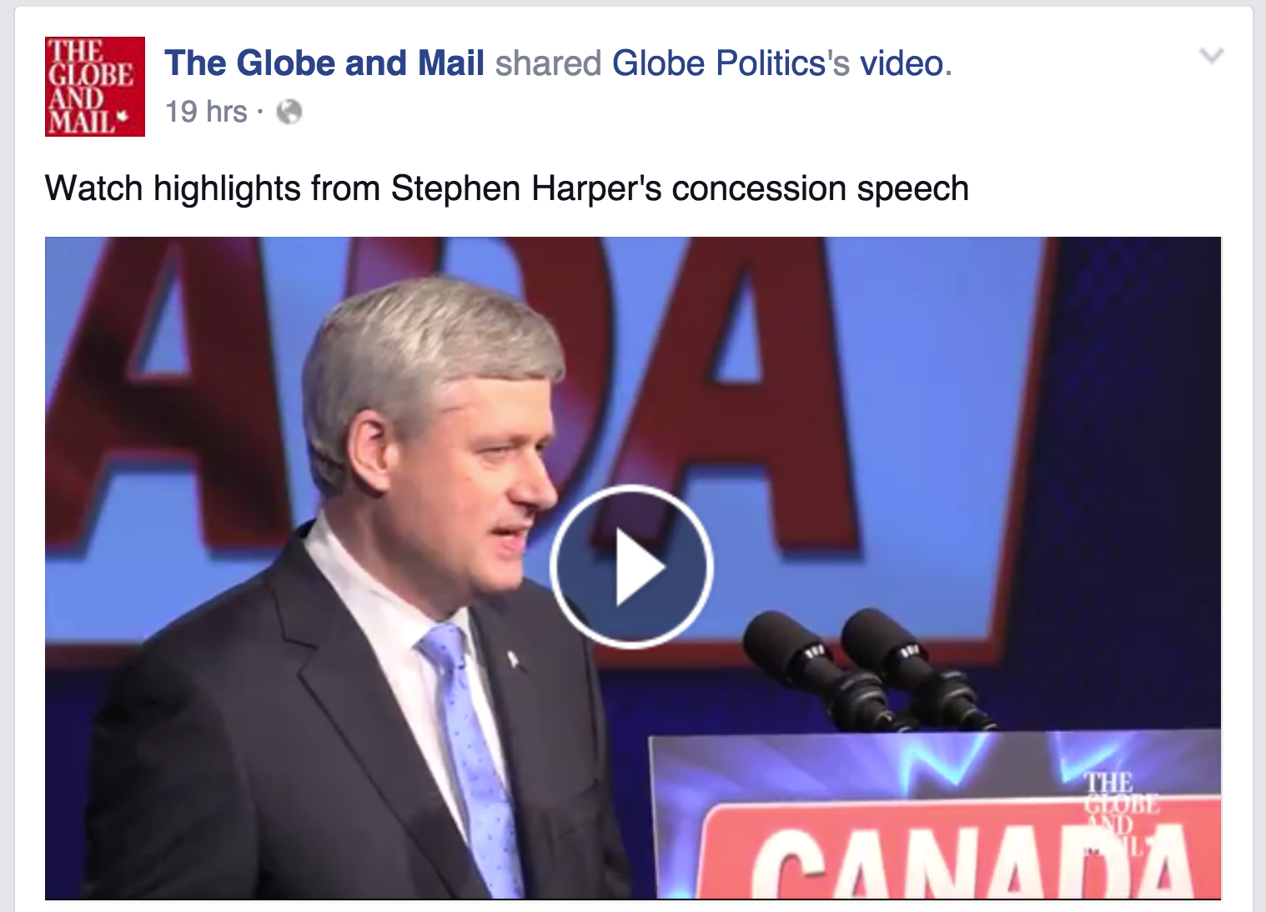
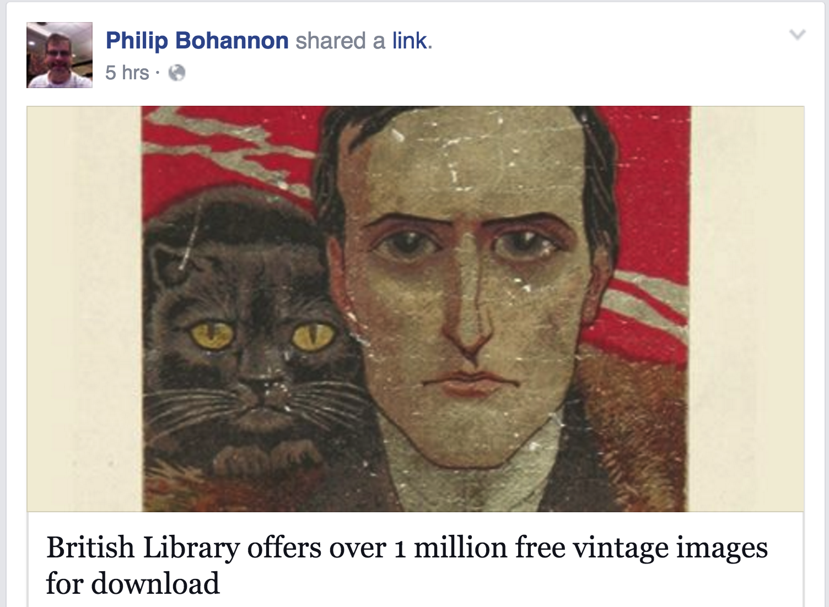
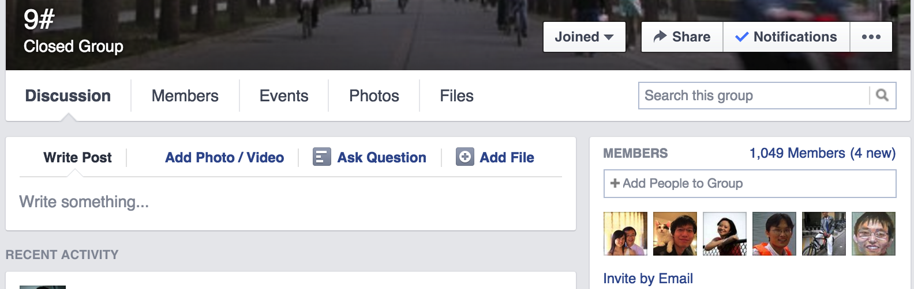
Observation: Multiple Domains

Slide 34
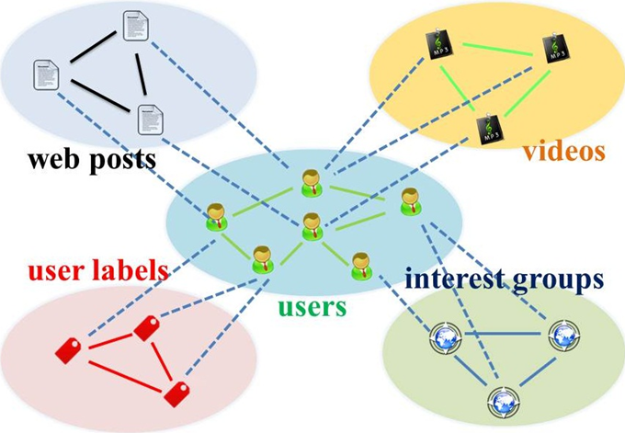
Representation: Start-Structured Graph

Slide 35
Representation: Social Bridge
Rtgt
Raux1
Raux3
Raux2
Bridge: Tie strength

Slide 36
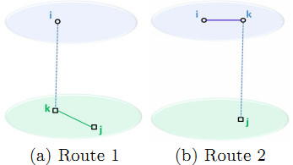
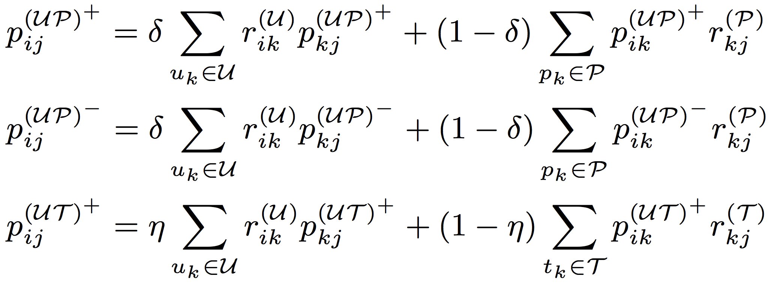
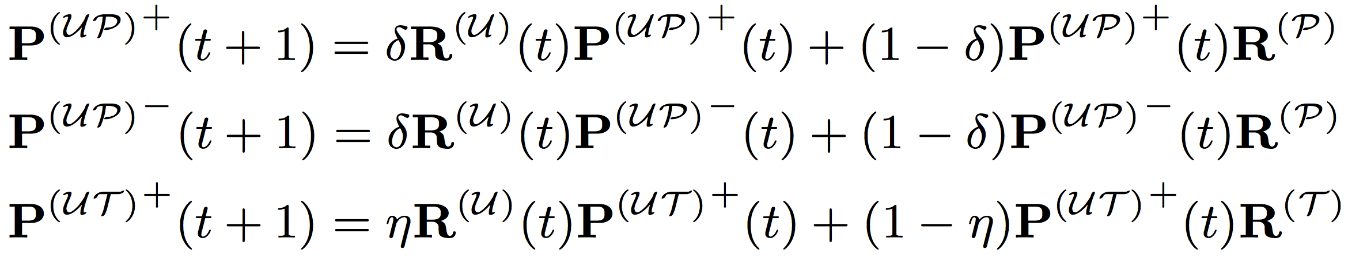
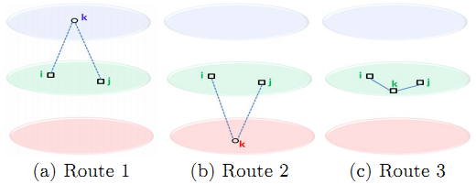
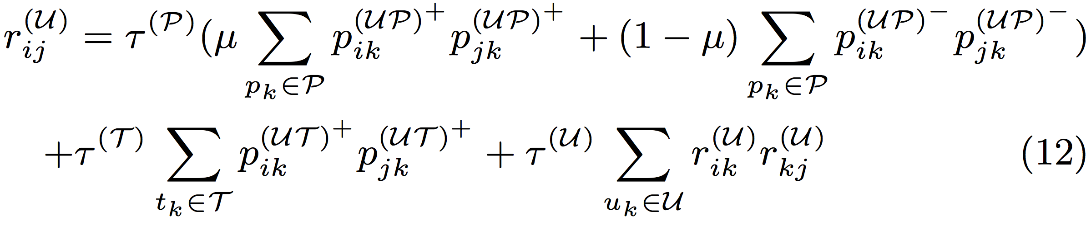
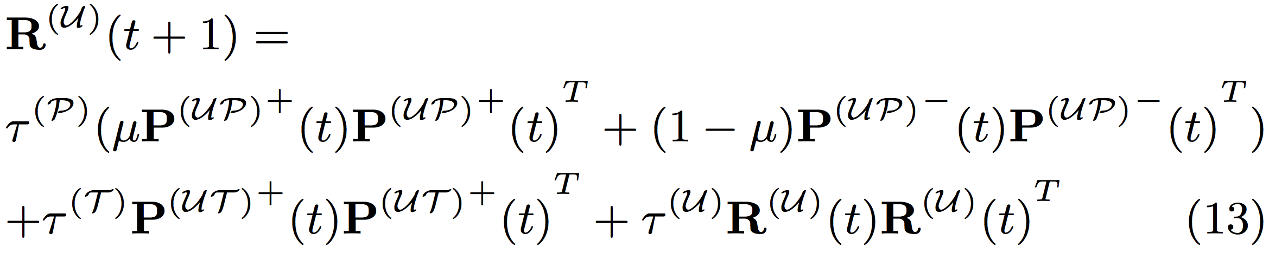
Algorithm: Hybrid Random Walk
Updating cross-domain links
Updating within-domain links

Slide 37
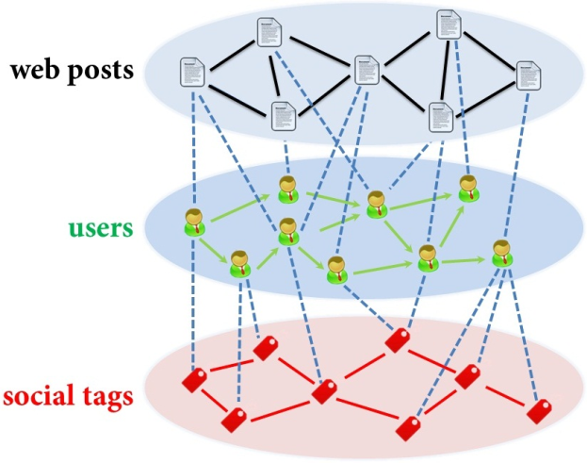
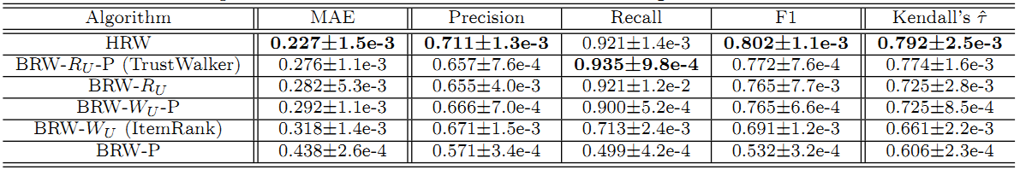
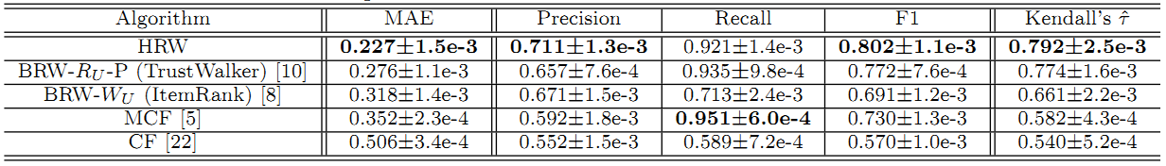
Results
Comparing with Random Walk with Restarts Models
Comparing with Social Recommendation Baselines

Slide 38
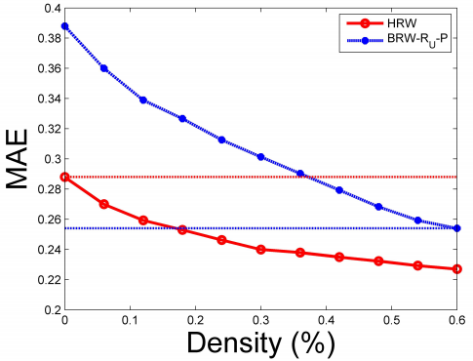
Results: Insight
Knowledge transfer from auxiliary domains improves cold-start users’ behavior prediction
Using aux. (label) data, saving 60-70% tgt. (post) data
35% user-post
0 user-label
0 user-post
100% user-label
60% user-post
0 user-label
18% user-post
100% user-label

Slide 39
Roadmap
Context
W1: Modeling social contexts (CIKM’12, TKDE’14, 129 citations) – online environment (mechanism)
W2: Modeling spatiotemporal contexts (KDD’14, 10 citations) – physical environment
Source
W3: Modeling cross-domain behaviors (CIKM’12, TKDE’15, 47 citations)
W4: Modeling cross-platform behaviors (AAAI’16)

Slide 40

Observation: Multiple Platforms

Slide 41
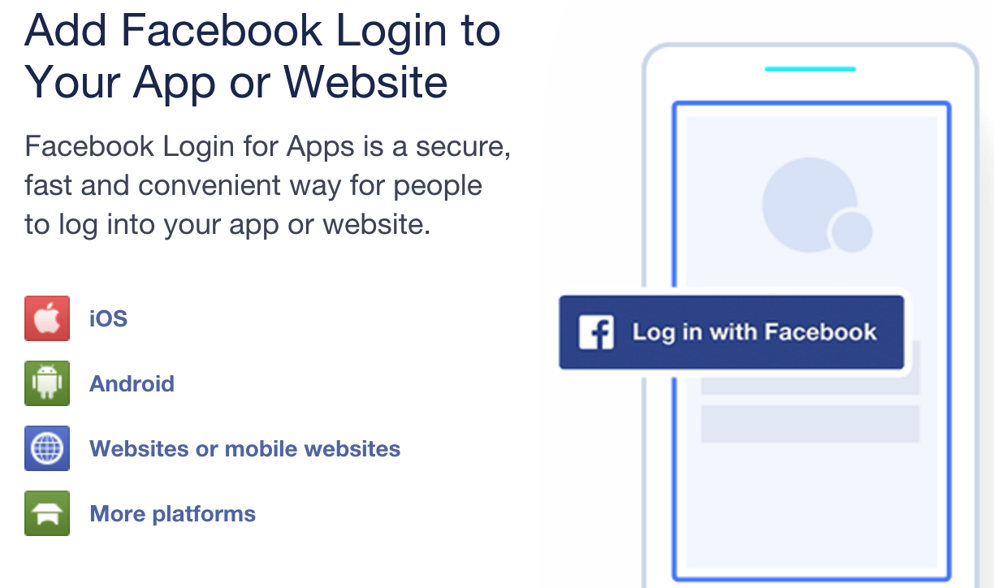
Observation: Cross-Platform

Slide 42



Observation: Partially Overlapped Crowds

Slide 43
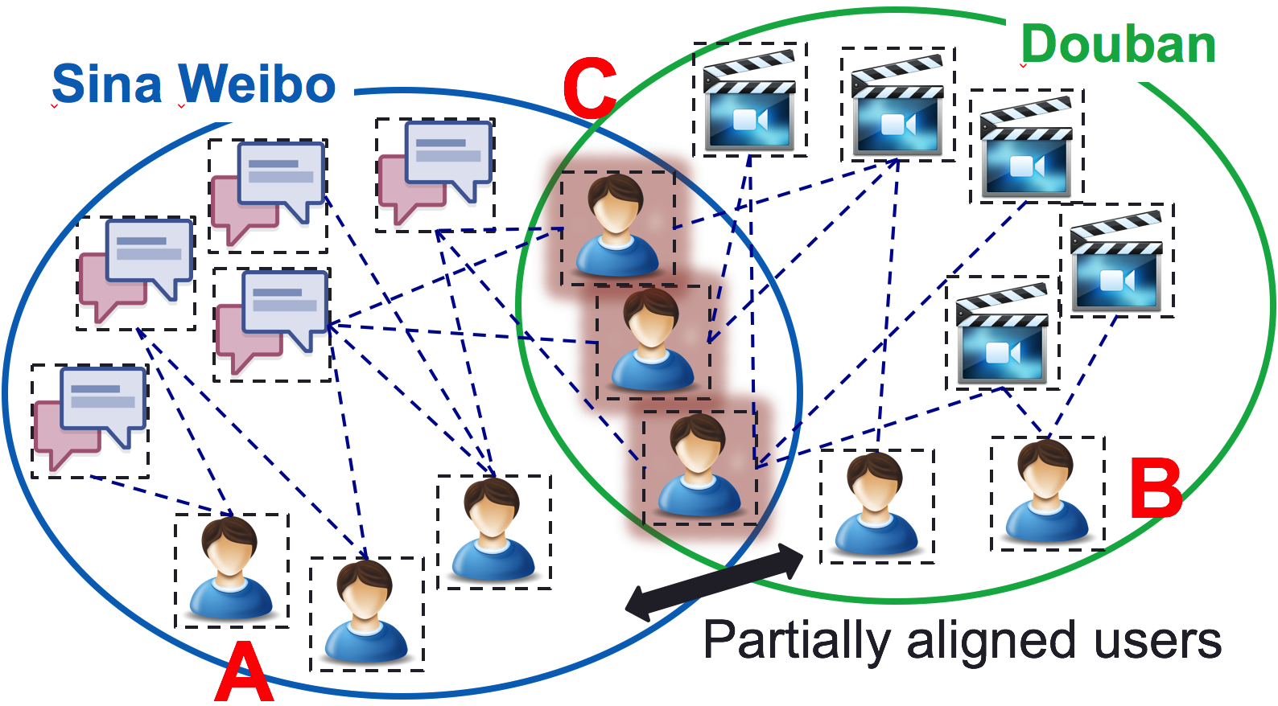
Representation: When NO Transfer
Sina Weibo
tags/entities
Douban
movies/books
User set | Weibo tweet entity to Douban movie
 | RMSE | MAP
A | Auxiliary platform data!
C | 0.779 | 0.805
B | 1.439 | 0.640
Sina Weibo
users
A
C
Douban
users
B
User set | Douban book to Weibo social tag
 | RMSE | MAP
A | 0.429 | 0.464
C | 0.267 | 0.666
B | Auxiliary platform data!

Slide 44
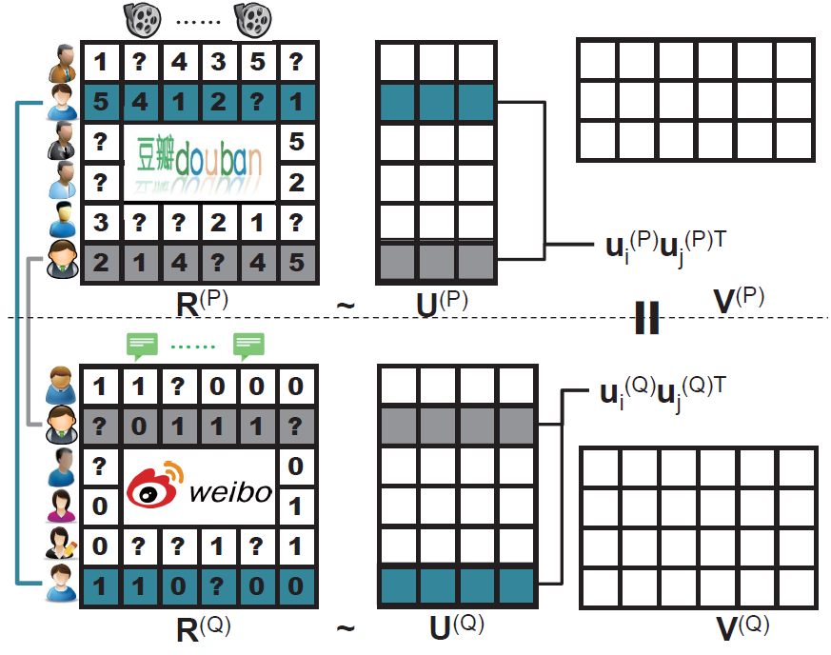
Algorithm: XPTrans

Slide 45
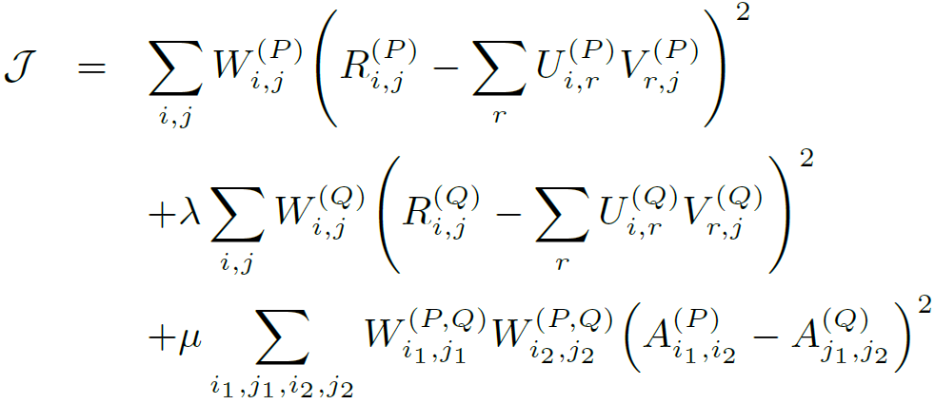
Algorithm: XPTrans
Input
Tgt./Aux. platform P/Q;
Behavior data R(P)/R(Q);
Observation W(P)/W(Q);
Overlapping indicator W(P,Q),
Output
User latent representation U(P)/U(Q);
Item latent representation V(P)/V(Q);
Missing values in R(P)
Objective function
Target platform
Auxiliary platform
Overlapping user similarity
(Pair-wise regularization)

Slide 46
Results: Leveraging Auxiliary Platform Data
Transfer via the Same
Latent Space
NO Transfer
User set | Weibo tweet entity to Douban movie
 | RMSE | MAP
A | Auxiliary platform data!
C | 0.779 | 0.805
B | 1.439 | 0.640
User set | Weibo tweet entity to Douban movie
 | RMSE | MAP
A
C | 0.757 | 0.811
B | 1.164 (-19%) | 0.702 (+9.7%)
User set | Douban book to Weibo social tag
 | RMSE | MAP
A | 0.429 | 0.464
C | 0.267 | 0.666
B | Auxiliary platform data!
User set | Douban book to Weibo social tag
 | RMSE | MAP
A | 0.411 (-4.2%) | 0.487 (+5.0%)
C | 0.256 | 0.681
B

Slide 47
Results: Leveraging Different Latent Spaces
Transfer via the Same
Latent Space
Transfer via Different
Latent Spaces
User set | Weibo tweet entity to Douban movie
 | RMSE | MAP
A
C | 0.757 | 0.811
B | 1.164 | 0.702
User set | Weibo tweet entity to Douban movie
 | RMSE | MAP
A
C | 0.715 | 0.821
B | 0.722 (-38%) | 0.820 (+17%)
User set | Douban book to Weibo social tag
 | RMSE | MAP
A | 0.411 | 0.487
C | 0.256 | 0.681
B
User set | Douban book to Weibo social tag
 | RMSE | MAP
A | 0.374 (-11%) | 0.533 (+12%)
C | 0.236 | 0.705
B

Slide 48
Results: Where Amazing Happens
Transfer via Different
Latent Spaces
NO Transfer
User set | Weibo tweet entity to Douban movie
 | RMSE | MAP
A | Auxiliary platform data!
C | 0.779 | 0.805
B | 1.439 | 0.640
User set | Weibo tweet entity to Douban movie
 | RMSE | MAP
A
C | 0.715 | 0.821
B | 0.722 | 0.820
User set | Douban book to Weibo social tag
 | RMSE | MAP
A | 0.429 | 0.464
C | 0.267 | 0.666
B | Auxiliary platform data!
User set | Douban book to Weibo social tag
 | RMSE | MAP
A | 0.374 | 0.533
C | 0.236 | 0.705
B

Slide 49
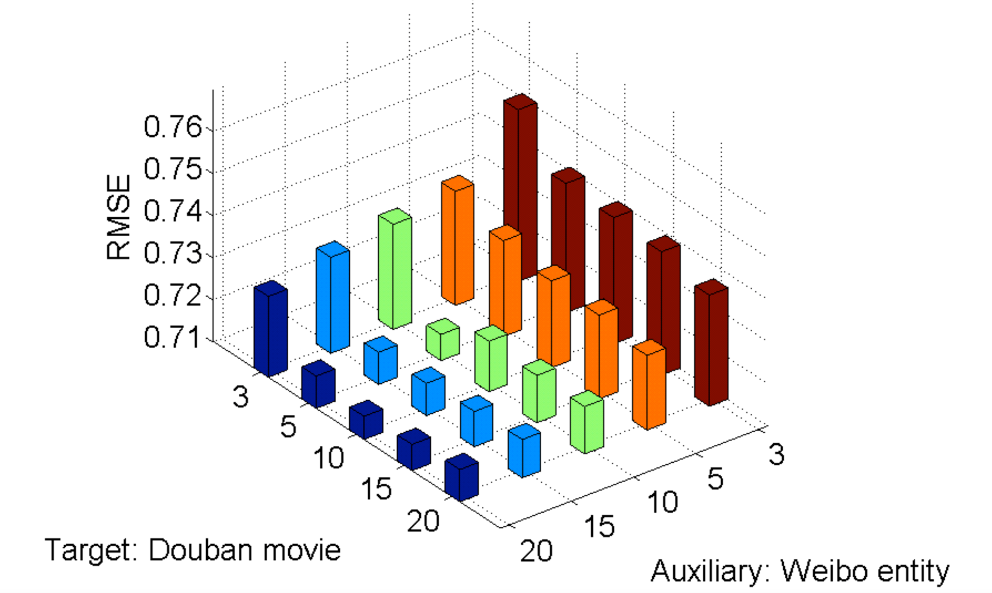
Results: Different Sizes of Latent Spaces

Slide 50
Data-Driven Behavioral Analytics
Social
(CIKM’12, TKDE’14)
Context
Spatiotemporal
(KDD’14)
Prediction and Recommendation
Content
Aspect and Attribute Mining
Summarization
(KDD’16)
Cross-Domain
(CIKM’12, TKDE’15)
Source
Cross-Platform
(AAAI’16)
Intention
Spotting and Catching
(WWW’14, PAKDD’14, KDD’14 Best Paper Finalist, KAIS’15, TKDD’16)
Suspicious Behavior Detection
(ISSI’16)
Evaluating Suspiciousness
(ICDM’15, TKDE’16)

Slide 51
References
[1] Meng Jiang, Peng Cui, Rui Liu, Qiang Yang, Fei Wang, Wenwu Zhu, Shiqiang Yang. “Social Contextual Recommendation”, ACM CIKM 2012.
[2] Meng Jiang, Peng Cui, Fei Wang, Wenwu Zhu, Shiqiang Yang. “Scalable Recommendation with Social Contextual Information”, IEEE TKDE 2014. (IF=2.07)
[3] Meng Jiang, Peng Cui, Fei Wang, Xinran Xu, Wenwu Zhu, Shiqiang Yang. “FEMA: Flexible Evolutionary Multi-Faceted Analysis for Dynamic Behavioral Pattern Discovery”, ACM SIGKDD 2014. (Oral, ACC=14.6%)
[4] Meng Jiang, Peng Cui, Fei Wang, Qiang Yang, Wenwu Zhu, Shiqiang Yang. “Social Recommendation across Multiple Relational Domains”, ACM CIKM 2012.
[5] Meng Jiang, Peng Cui, Xumin Chen, Fei Wang, Wenwu Zhu, Shiqiang Yang. “Social Recommendation with Cross-Domain Transferable Knowledge”, IEEE TKDE 2015. (IF=2.07)
[6] Meng Jiang, Peng Cui, Nicholas Jing Yuan, Xing Xie, Shiqiang Yang. “Little is Much: Bridging Cross-Platform Behaviors through Overlapped Crowds”, AAAI 2016.

Slide 52
Thank you!

Slide 53
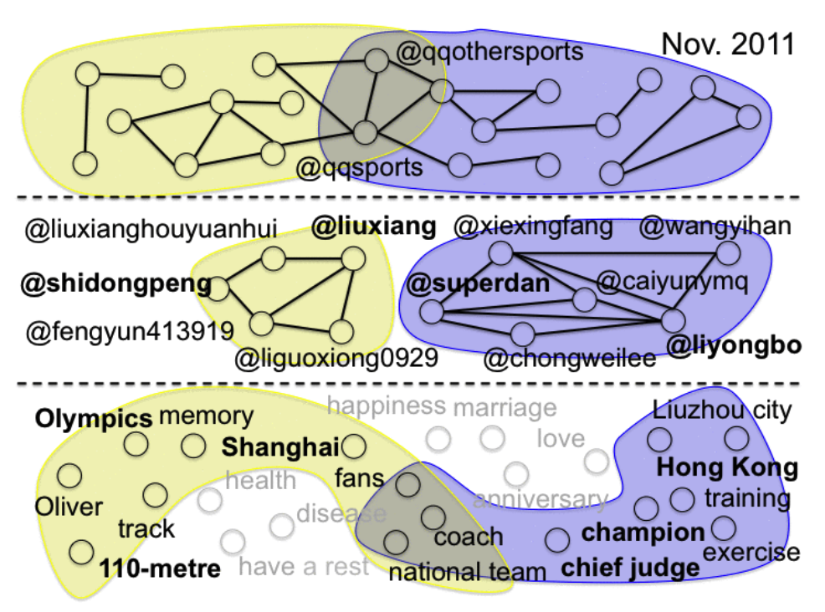
Results (FEMA)

Slide 54
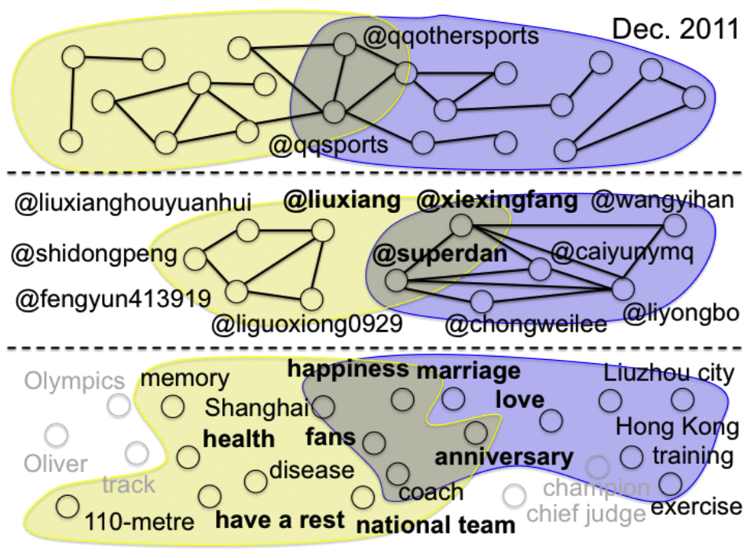
Results (FEMA)

Slide 55
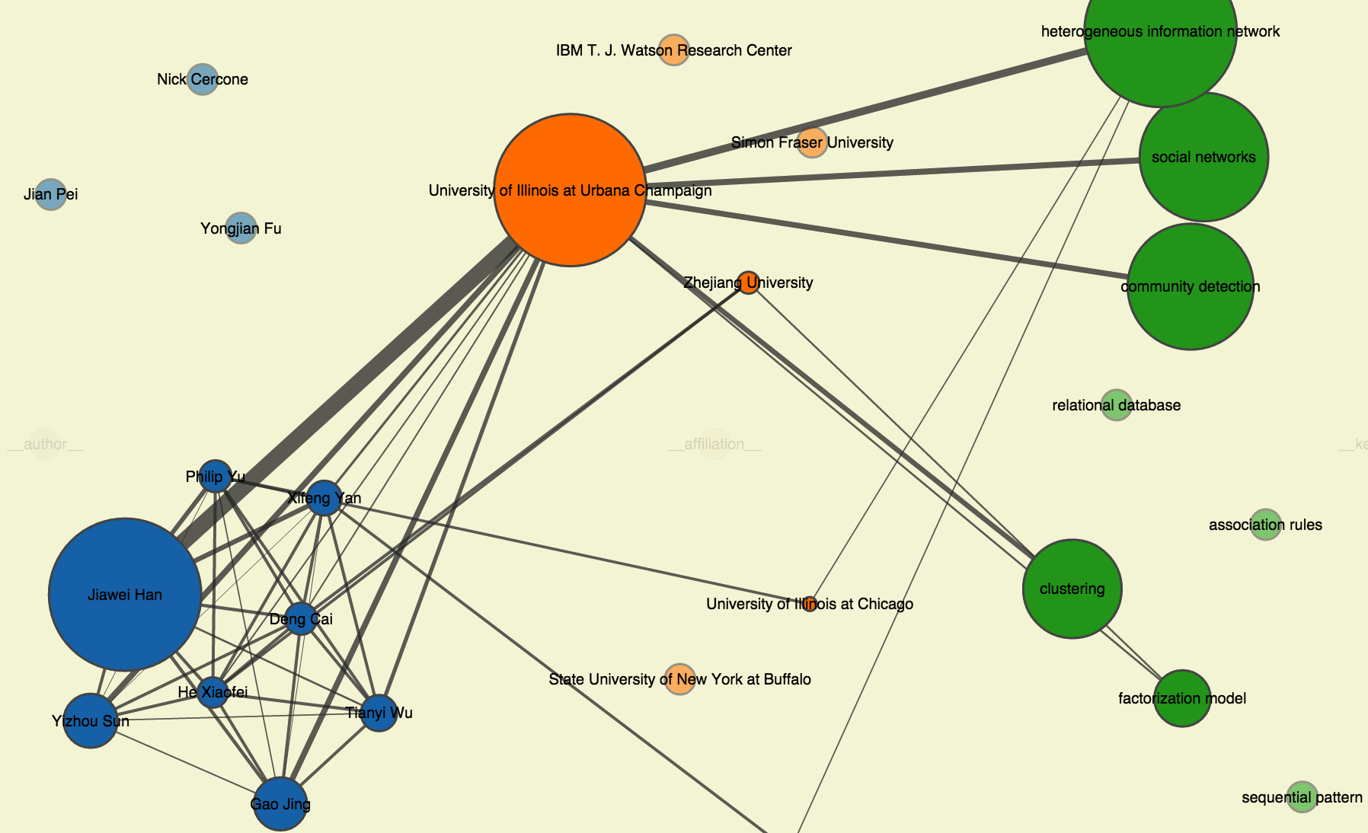
Results (FEMA)
http://www.meng-jiang.com/demos/fema/mas/

Slide 56

Results (XPTrans)
A→B
C
C
A→B

